Slide 1
Medians and Order Statistics

Slide 2
Order statistics
The i^{th} order statistic of a set of n elements = the i^{th} smallest element
Minimum = 1st order statistic (i = 1)
Maximum = n^{th} order statistic (i = n)
Median = i = lower median or i = upper median

Slide 3
Selection problem
Input: A set A of n (distinct) numbers and an integer i, with 1 <= i <= n.
Output: The element x A that is larger than exactly i - 1 other elements of A.

Slide 4
Selection problem
We can solve it in O(nlgn) time
Sort the numbers using merge sort or heapsort, then take the i^{th} element.

Slide 5
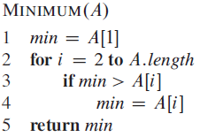
Minimum and maximum
n-1 comparisons are necessary to find the minimum.
n-1 comparisons are necessary to find the maximum.
Maximum(A)
max
max <
max
max

Slide 6
Simultaneous minimum and maximum
How many comparisons are needed to find both minimum and maximum?
n-1 + n-1 = 2n-2
Can we do it better?
Yes
3
8
4
1
6
9
7
2
5
<
min
Min = A[1]
Max = A[1]
<
<
<
<
max
<

Slide 7
Simultaneous minimum and maximum
How many comparisons are required?
3*(n-1)/2 if n is odd
3*(n-2)/2 +1 if n is even
3* in either case

Slide 8
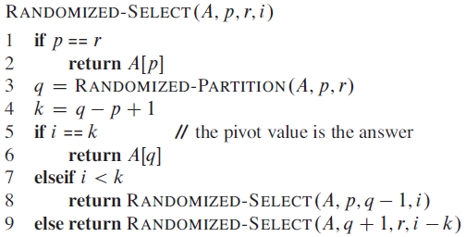
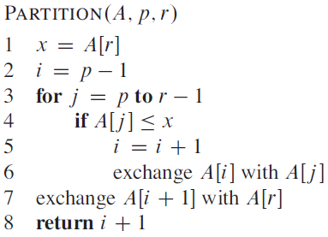
Randomized select algorithm

Slide 9
Randomized select algorithm
i=3
p=1
p=9
k
3
8
4
1
6
9
7
2
5
pivot
1
2
4
3
5
9
7
8
6
k

Slide 10
Randomized select algorithm
T(n) = T(n/2) + Θ(n)
a=1, b=2, f(n)=Θ(n)
Θ(n) ? n^{lgba} = n^{lg21} = n⁰
Θ(n) = Ω(n^{0+e}) => 3rd case
Check regularity condition
a*f(n/b) <= c*f(n)
f(n/2) <= cdn
dn/2 <= cdn ➔ 1/2 <= c ➔ c=2/3 < 1
T(n) = Θ(f(n)) = Θ(n)

Slide 11
Randomized select algorithm
<- worst case
T(n) = T(n-1) + Θ(n)
T(n) = T(n-1) + cn
T(n) = cn + c(n-1) + T(n-2)
T(n) = cn + c(n-1) + c(n-2)…c2+c1
T(n) =c* = O(n²)

Slide 12
Selection in worst-case linear time
Uses recursive calls to solve the selection problem.
Different from randomized selection is here the partitioning guarantees a good split.

Slide 13




Selection in worst-case linear time

Slide 14
Selection in worst-case linear time
T_{1,2}(n) = O(n)

Slide 15
Selection in worst-case linear time
x
T₄(n) =

Slide 16
Selection in worst-case linear time
x
T₄(n) = O(n)
x

Slide 17
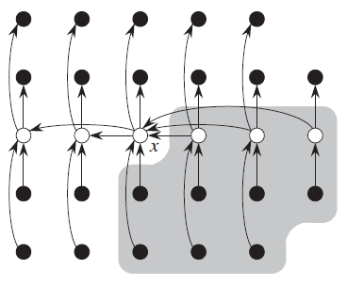


Selection in worst-case linear time
T₅(n) = ?
Number of elements larger than x ?
=
T₅(n) = T(7n/10 + 6)

Slide 18


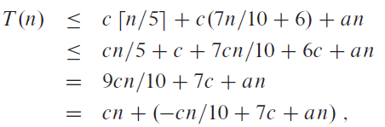

Selection in worst-case linear time
By substitution method:
T(n) = O(n)

